Slide 1
Power Management

Slide 2
802.11 Power Management
How 802.11 power management protocols allow wireless
radios go to sleep.
The operation of 802.11 Power Management.
The use of Power Save Poll frames.
The operation of 802.11e Unscheduled Automatic Power Save Delivery.
The purpose of Null data frames as it relates to power management.
The operation of 802.11n Power Save Multi-Poll.

Slide 3
Wireless Radios and Battery Life
A wireless radio can perform one of four activities. It can be
  Asleep
  Idle and awake
  Receiving
  Transmitting

Slide 4
Power Save Modes
There are two Power Save modes in 802.11 stations, active mode and Power Save mode:
  Active Mode ​ ​Stations and APs operate with the assumption that the station is always available to transmit and receive data.
  Power Save Mode ​ ​The AP operates under the assumption that a station radio is sleeping and therefore unable to receive frame transmissions.
  Power States
  Doze State ​ ​The station is saving the most battery life.
  Awake State ​ ​The station may either be idle, receiving, or transmitting.

Slide 5
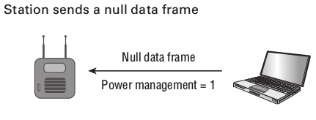
Cntd ...
Before a station goes into the doze state, it sends a frame, usually a null data frame, to the AP indicating that power management is enabled.

Slide 6
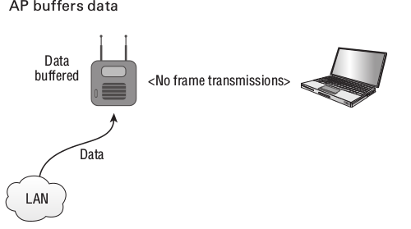
802.11 Power Management
Once the station indicates that it is in Power Save mode, the AP begins to buffer all frames destined to that station.

Slide 7
Buffered traffic and Traffic Indication Map (TIM) element

Slide 8
802.11 Power Management

Slide 9
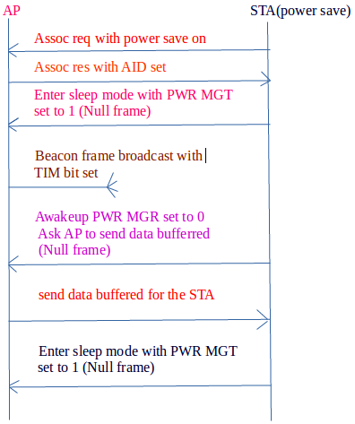
802.11 Power Management

Slide 10
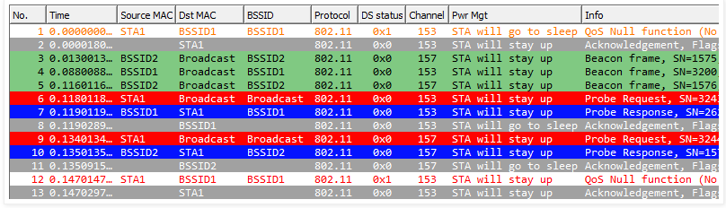
802.11 Power Management

Slide 11
802.11 Power Management

Slide 12
802.11 Power Management

Slide 13
802.11 Power Management
The operation of 802.11 Power Management.
The use of Power Save Poll frames.
The operation of 802.11e Unscheduled Automatic Power Save Delivery.
The purpose of Null data frames as it relates to power management.
The operation of 802.11n Power Save Multi-Poll.

Slide 14
802.11 Power Management
The operation of 802.11 Power Management.
The use of Power Save Poll frames.
The operation of 802.11e Unscheduled Automatic Power Save Delivery.
The purpose of Null data frames as it relates to power management.
The operation of 802.11n Power Save Multi-Poll.

Slide 16
802.11 Power Management

